Slide 1

COURSE AND SYLLABUS DESIGN

Slide 2
.WHAT IS SYLLABUS DESIGN
Syllabus design can be defined as selection and organization of instructional content including suggested strategy for presenting content and evaluation
•Whereas, Curriculum is a broad description of general goals by indicating an overall educational-cultural philosophy which applies across subjects together with a theoretical orientation to language and language learning.

Slide 3
PLANNING THE COURSE STRUCTURE
Two aspects in the process of planning
Selecting a syllabus framework
Developing instructional blocks

Slide 4
THE COURSE DESIGN PROCESS
context
needs
goals
feedback
learner
syllabus
evaluation
approach
goals
feedback

Slide 5
THE DECISION-MAKING PROCESS
START
Selection of learning experience
Statement of general goals
Organization of learning experiences
Diagnosis of needs
Formulate detailed procedures
Evaluaion
Formulation of objectives
Implement procedures
Satisfactory
Selection of content
END
Organization of content

Slide 6
MAIN PRINCIPLES OF SYLLABUS DESIGN
A view of how language is learned results in a process-based syllabus
A view of how language is acquired results in a structure-based syllabus
A view of how language is used results in a function-based syllabus

Slide 7
TYPES OF SYLLABUS
Grammatical
Lexical
Functional
Topical
Task-based

Slide 8
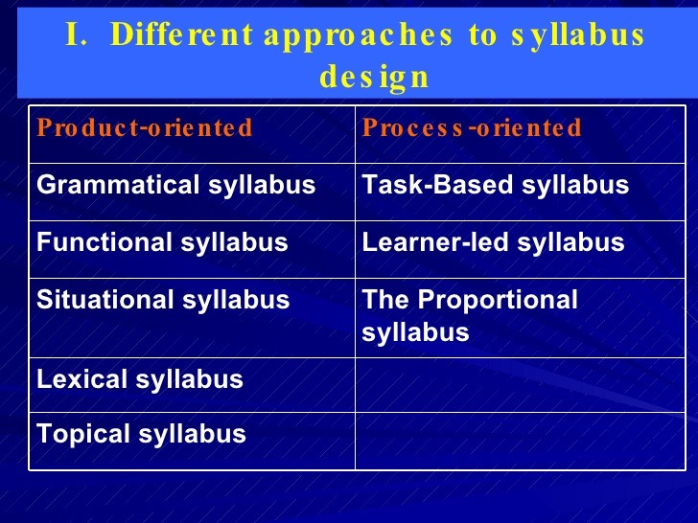
DIFFERENT APPROACHES

Slide 9
GRAMATICAL SYLLABUS
used to solve such problems:
selecting sufficient patterns to support the amount of teaching time available
arranging items into a sequence to facilitate learning
identifying a productive range of grammatical items to develop basic communication skills

Slide 10
DISADVANTAGES OF GRAMMATICAL APPROACH
Represent only a partial dimension of language proficiency
Do not reflect the acquisition sequences seen in natural environment
Focus on the sentence rather than on longer units of discourse
Focus on form rather than on meaning
Do not address communicative skills

Slide 11
LEXICAL SYLLABUS
Identifies a target vocabulary to be taught and is arranged according to such levels as
ELEMENTARY ( 1.000 WORDS)
INTERMEDIATE ( 2.000 WORDS)
UPPER INTERMEDIATE (+ 2.000 WORDS)
ADVANCED (++ 2.000 WORDS)

Slide 12
FUNCTIONAL SYLLABUS
Organized around such communicative functions as
requesting
complaining,
suggesting
agreeing

Slide 13
ADVANTAGES OF FUNCTIONAL SYLLABUS
Reflecting a more comprehensive view of language and focusing on the use of the language
Can be linked to other types of syllabus content
Providing convenient framework for the design
of teaching materials, particularly in the domains of listening and speaking

Slide 14
DISADVANTAGES OF FUNCTIONAL SYLLABUS
The lack of clear criteria for selecting or grading functions
Simplistic view of communicative competence
Failure to address the process of communication
Atomistic approach to language
Concentration on expressions and idioms
Negative result on grammatical competence

Slide 15
SITUATIONAL SYLLABUS
Organized around the language required for different situations where particular communicative acts are typically occur.
Ex: (1) on an airplane
(2) at an immigration counter
(3) at a bank
(4) on the telephone) etc.

Slide 16
DISADVANTAGES OF SITUATIONAL SYLLABUS
Language used in specific situations may not be transferred to other ones
Often leads to phrase-book approach
Grammar is dealt with incidentally thus resulting in gaps in grammatical knowledge

Slide 17
TOPICAL SYLLABUS
Organized around themes, topics or other units of the content

Slide 18
ADVANTAGES OF TOPICAL SYLLABUS
Facilitating comprehension
making linguistics form more meaningful and serves as the best basis for teaching the skill areas
Addressing students’ needs and motivate them
Providing the integration of four skills
Increasing the use of authentic materials

Slide 19
COMPETENCY-BASED SYLLABUS
Based on a specification of learners’ competences and aimed to master language in relation to specific situations and activities
Widely used in social survival and work-oriented language programs

Slide 20
TEXT-BASED SYLLABUS
Built around texts and samples of extended discourse
Considered to be a type of integrated syllabus as it combines elements of different types of syllabus

Slide 21
SKILLS SYLLABUS
Organized around the different underlying abilities involved in using language for such purposes as reading, writing, listening and speaking

Slide 22
SKILLS SYLLABUS
ADVANTAGES
Focus on performance in relation to specific tasks
Provide a practical framework for designing courses and teaching materials
DISADVANTAGES
lack of serious basis for determining skills
Focus on discrete aspects of performance rather than on developing more global and integrated communicative abilities

Slide 23
TASK-BASED SYLLABUS
Uses activities that the learners have to do for noninstructional purposes outside of the classroom as opportunities for language learning
Tasks are distinct from other activities to the degree that they have a noninstructional purpose and measurable outcome.
Tasks are way of bringing the real world into the classroom

Slide 24
ADVANTAGES OF TASK-BASED SYLLABUS
potentially very powerful and widely applicable
suitable for learners of all ages and backgrounds
addresses the crucial problem-directly, by using active and real tasks as learning activities
improve ability to perform the instructional tasks
learners are engaged in relatively similar out-of-class activities (social or academic)
enhance cognitive, cultural, and life skills along with the language

Slide 25
DISADVANTAGES OF TASK-BASED SYLLABUS
problems can easily arise with teachers, the instructional setting, or the students,
requires resources beyond the text books
students may resist or object to this type of instruction
evaluation can be difficult, however, it is easy to measure the language proficiency

Slide 26
WHAT TYPE OF SYLLABUS SHOULD BE USED
It should be kept in mind that the question is not which type to choose but which types and how to connect them with the other. No single type of syllabus is appropriate for all teaching settings.
It depends on how you teach. Choose one that fits your teaching procedures.
Don’t forget to use multiple types.

Slide 27

THANK YOU FOR ATTENTION

